Slide 1

Adopting Automation in Agile Testing
Project id: E9953
Feb 2014
Confidential | Copyright © Larsen & Toubro Infotech Ltd.

Slide 2





Agenda
1
4
Overview
The Mitigations
3
The Blocks
2
2
5
What is Automation in Agile
Some Metrics
Confidential | Copyright © Larsen & Toubro Infotech Ltd.

Slide 3






The Challenges
Confidential | Copyright © Larsen & Toubro Infotech Ltd.

Slide 4




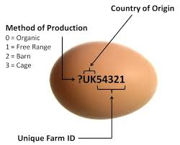

Ways to streamline
Confidential | Copyright © Larsen & Toubro Infotech Ltd.

Slide 5


Thank you
Our Business Knowledge,
Your Winning Edge.
Confidential | Copyright © Larsen & Toubro Infotech Ltd.

